Slide 1


MACHINE LEARNING LAB
Introduction to scikit-learn
Suneela Zafar
School of Electrical Engineering and Computer Science (SEECS), NUST, Pakistan

Slide 2
What is Scikit-learn?
Scikit-learn (Sklearn) provides a selection of efficient tools for machine learning and statistical modeling including classification, regression, clustering and dimensionality reduction.
Built on top of NumPy, SciPy, and Matplotlib.

Slide 3
Compatibility Check
Python (>=3.5)
NumPy (>= 1.11.0)
Scipy (>= 0.17.0)
Matplotlib (>= 1.5.1) is required for Sklearn plotting capabilities.
Pandas (>= 0.18.0) is required for some of the scikit-learn examples using data structure and analysis.

Slide 4
Scikit-learn Modelling Process
The standard workflow includes:
Data Loading
Preprocessing
Splitting Data
Model Selection
Model Training
Prediction
Evaluation

Slide 5
Data Loading
Scikit-learn can load sample datasets or read data from files (CSV, Excel, etc.).
from sklearn import datasets
iris = datasets.load_iris()
print(iris.data[:5])

Slide 6
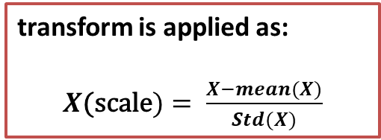
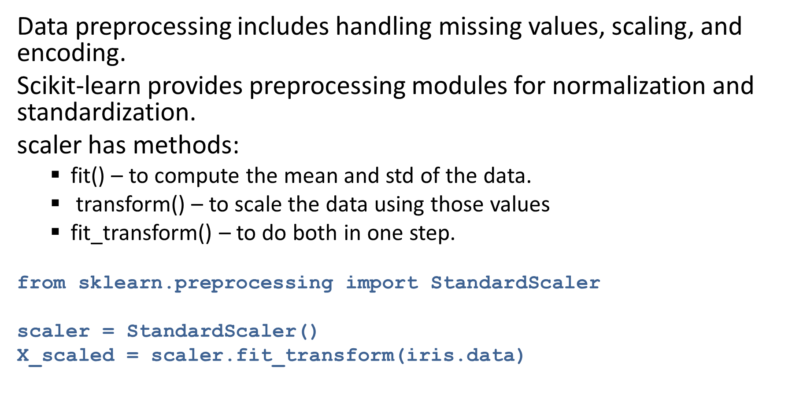
Data Preprocessing
Data preprocessing includes handling missing values, scaling, and encoding.
Scikit-learn provides preprocessing modules for normalization and standardization.
scaler has methods:
  fit() – to compute the mean and std of the data.
  transform() – to scale the data using those values
  fit_transform() – to do both in one step.
from sklearn.preprocessing import StandardScaler
scaler = StandardScaler()
X_scaled = scaler.fit_transform(iris.data)
transform is applied as:
$X\text{(}\text{scale})= \frac{X−mean(X)}{Std(X)}$

Slide 7
Splitting Data
Before training, data is divided into training and testing sets using train_test_split.
from sklearn.model_selection import train_test_split
X_train, X_test, y_train, y_test = train_test_split(iris.data, iris.target, test_size=0.2, random_state=42)

Slide 8
Model Selection
Scikit-learn provides various algorithms such as:
Linear Regression
Decision Trees
SVM
KNN
Random Forests
from sklearn.linear_model import LogisticRegression
model = LogisticRegression()

Slide 9
Training the Model
Fit the model to the training data using the .fit() method.
model.fit(X_train, y_train)

Slide 10
Making Predictions
Once trained, the model can make predictions on new data using .predict().
y_pred = model.predict(X_test)
print(y_pred[:10])

Slide 11
Evaluating the Model
Scikit-learn provides metrics like accuracy_score, confusion_matrix, and classification_report.
from sklearn.metrics import accuracy_score
print('Accuracy:', accuracy_score(y_test, y_pred))

